Slide 1
Exeter Maths School Industry Projects 2019 Breaking DSA
Amy H, James S and Mairi W

Slide 2
What is GCHQ?

Slide 3

What does GCHQ do?
We work with law enforcement, the military and the UK’s other intelligence agencies.
Counter Terrorism - Stopping terrorist attacks in the UK and against our interests overseas
Cyber Security - Making the UK the safest place to live and do business online through the National Cyber Security Centre (NCSC)
Strategic Advantage - Managing the threats from hostile states, promoting the UK's prosperity and shaping the international environment
Serious & Organised Crime - Reducing the social and financial harm that serious and organised crime causes to the UK
Support to Defence - Protecting Defence personnel and assets and supporting an integrated approach to war fighting
Where does maths fit into this?

Slide 4
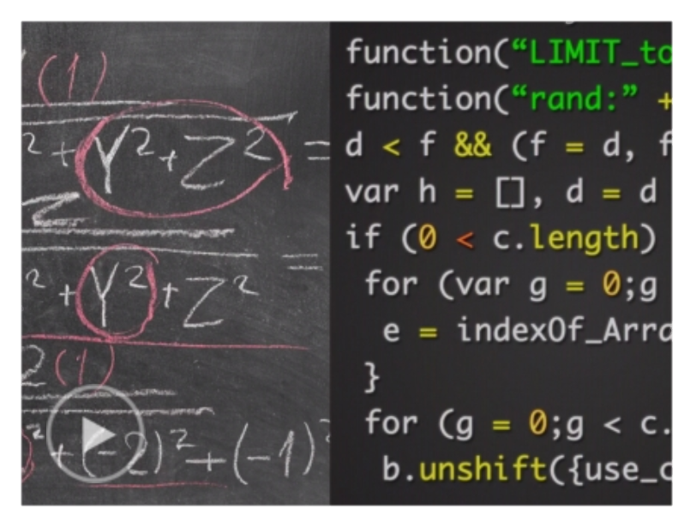
Mathematics at GCHQ
GCHQ employs mathematicians to fill a variety of roles, including:
Cryptographic research
Cryptographic engineering and consulting
Data science
Machine learning research
Some roles involve researching new mathematics and working with academia, some roles focus on understanding and applying existing mathematics, and others utilise mathematical problem-solving skills. Most roles involve considerable amounts of programming.

Slide 5
What is cryptography?

Slide 6
Introducing cryptography
Cryptography
Kryptós + graphein
"hidden, secret” + "to write”
Cryptography is the art and science of securing communications.
One example of cryptography is encryption.

Slide 7
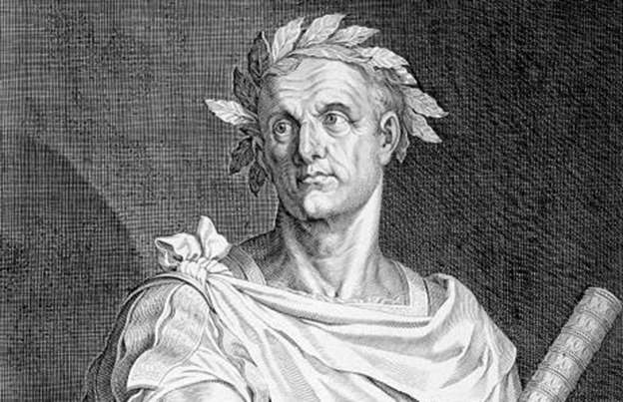
The Caesar Cipher
Julius Caesar encrypted messages by shifting letters backwards in the alphabet by three:
ABCDEFGHIJKLMNOPQRSTUVWXYZ XYZABCDEFGHIJKLMNOPQRSTUVW
THE QUICK BROWN FOX…
QEB NRFZH YOLTK CLU…
The message is deciphered by shifting the letters forwards in the alphabet by three.
The technique can be generalised by shifting by a number other than three.

Slide 8


Symmetric encryption
Symmetric encryption involves taking a plaintext message and encrypting it using an algorithm and a key to get a ciphertext.
Algorithm
Plaintext
Ciphertext
It is called symmetric because the same key is used for both encryption and decryption.
What do you think it’s more important to keep secret, the key or the algorithm?

Slide 9
Symmetric encryption algorithms
Modern symmetric encryption algorithms have been standardised
Advanced Encryption Standard (AES)
The security of a symmetric encryption algorithm relies on the size of the key space
AES key sizes are 128, 192 or 256 bits
Attacks often rely on trying huge numbers of keys, so need powerful computers
Symmetric encryption algorithms are usually very fast, so good for bulk encryption
The problem is how to share the key?

Slide 10


Public key cryptography
Public key (asymmetric) cryptography was pioneered in the 1970s. It uses pairs of keys: A public key and a private key.
Bob’s public key
Bob’s private key
Alice
Bob
Algorithm
Algorithm
Plaintext
Ciphertext
Plaintext
It’s called asymmetric because different keys are used to encrypt and decrypt, or public key because it uses a key pair with a public key.

Slide 11
Public key encryption algorithms
The original public key encryption algorithm is RSA.
It’s named after those who first published it (in 1977): Rivest, Shamir and Adleman
But it was discovered at GCHQ four years earlier!
Key sizes are 1,024 to 4,096 bits
Public key algorithms generally have much larger keys and are relatively slow
They are often used to encrypt a key for a symmetric algorithm
Some public key algorithms are specifically designed to generate a shared symmetric key rather than encrypt a message (Diffie-Hellman, for example)

Slide 12
Other uses of cryptography
Encryption ensures the confidentiality of communications.
Cryptography can also be used in other ways to protect communications, including:
Ensuring the integrity of communications
Authenticating communications

Slide 13
Digital signatures

Slide 14

Signatures
Signatures are one of the oldest methods of authentication.
For hundreds of years people have signed letters to prove who wrote them.
Properties of signatures:
You can completely trust the link between signature and signer. A signature is unique to the signer and a signer can never deny that their signature belongs to them.
A signature is unforgeable. Even if you see someone’s signature, you still can’t reproduce it exactly.
If you sign something, it says “you can be sure that I personally am responsible this.”

Slide 15
Digital signatures
Digital signatures are a cryptographic analogue to handwritten signatures. They use public key cryptography.
If Alice wants to sign something:
She generates a key pair
She distributes her public key but keeps her private key secret
She signs messages with her private key
Anyone can use the public key to verify the signature on the message
Note: The signature is unique to the message as well as the key pair, so if the message is tampered with, the signature will not verify correctly.

Slide 16
Digital signatures
Microsoft uses digital signatures to authenticate software.
Microsoft has a private key that is kept very securely
Microsoft signs software using the private key
Your browser already has Microsoft’s public key installed
When you download the software, your browser verifies the signature
If the signature checks out, you know the software is genuinely from Microsoft
You also know the software hasn’t been tampered with

Slide 17
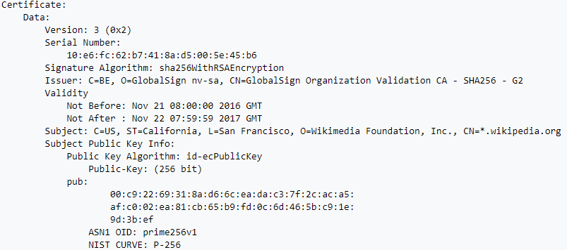

Certificates
How do you know you the public key your browser has is definitely Microsoft’s?
Public keys are often stored within certificates, signed by a trusted certification authority.
X.509 is the standard used on the internet for certificates. Many websites pay for a certificate so visitors know the site is legitimate. Browsers come with lists of certificates installed, and signatures are checked automatically when you visit websites.

Slide 18
The Digital Signature Algorithm

Slide 19
The Digital Signature Algorithm
The Digital Signature Algorithm:
Standardised by the National Institute of Standards and Technology (NIST) in 1991
Adopted as a US Federal Information Processing Standard (FIPS) for digital signatures in 1994
Patented, but free for anyone to use, anywhere in the world
How does it work?

Slide 20
Security of DSA
When DSA is correctly implemented, the only way to forge a signature is to obtain someone’s private key.
e.g. find x such that 𝑦 = 𝑔^{𝑥} mod P.
This is known as the discrete logarithm problem. The security of DSA relies solely on the fact that this problem is notoriously difficult to solve when the numbers are well-chosen.
So it sounds like DSA is unbreakable… But is it?

Slide 21
Vulnerabilities
DSA is often poorly implemented
If you deviate from the NIST standard in any way, you will likely seriously weaken the algorithm
Poor choices of k
Not checking that r and s are non-zero
Poor choice or implementation of hash function
Big name companies have fallen afoul of such mistakes, including Sony and Adobe

Slide 22
Breaking DSA

Slide 23
Project outline
Understanding DSA
Get to grips with the maths underlying the algorithm
Implementing DSA
Complete the skeleton Python code so you can generate key pairs, sign and verify
Learning how DSA can go wrong
What can you find online about DSA’s vulnerabilities?
Can you find real-life examples of where things have gone wrong?
Breaking DSA
Complete a sequence of challenges, exploiting vulnerabilities to break DSA
Going further
What other digital signature schemes are there?
How would quantum computers impact on the security of DSA signatures?

Slide 24
Contact Details
Amy.S@ncsc.gov.uk
James.S3@ncsc.gov.uk
Mairi.W@ncsc.gov.uk

